Slide 1

Scoping an Oracle Project for Azure
Kellyn Gorman
Customer Success Engineer, SME Oracle on Azure
Microsoft

Slide 2
Why Investigate Oracle Workloads as Part of the Azure Move?
In project reviews, it was found that older relational databases were 60% of the reason customers were less likely to move their data to the cloud.
Oracle is estimated to have almost 30% of database software, engineered systems and enterprise software products in enterprise environments today.
There is an opportunity to move these workloads into Azure as part of existing projects with Microsoft engaged customers.
Assisting customers to identify their global-data landscape and opportunities to move these database “anchors” can turn WHEN into NOW.

Slide 3
Oracle Migration Paths in Azure
Oracle to SQL Server 2019 Managed Instance, (SSMA Ora2SQL)
Oracle to Azure SQL PaaS , (DMA/DMS)
Oracle to PostgreSQL PaaS, (DMS Ora2PG)
OCI, (Oracle Cloud Infrastructure)/Azure Connect
Lift and Shift to IaaS VM in Azure, leaving database on Oracle

Slide 4
Project Beginning
Existing Oracle Environment
E-business Suite, Essbase, Hyperion
Vendor Supports only Oracle
Major Azure Projects Dependent
Simple implementation
Modules, Significant support
Less than 1 Year Turnaround
New Oracle Proposal
Supported Azure/OCI Region
In Unsupported Azure/OCI Region
Oracle on IaaS
OCI/Azure Connect
Continued

Slide 5
New Oracle Proposal
Existing Oracle Environment
Oracle Migrition, (Cont.)
Wants PaaS Solution
Agrees to 2+ year project
Developers Can’t be retrained
Major Azure Projects Dependent
Has Partner for Project
Dependent on Oracle
Unsupported Azure/OCI Region
Developers Know TSQL
Want to Decrease Licensing
Oracle on IaaS
OCI/Azure Connect
Azure SQL
MySQL on Azure
PostgreSQL on Azure

Slide 6
Platform Migration Challenges
SQL Server or Azure SQL:
No PL/SQL Functions
DBA retraining for large changes in management requirements
Development challenges with lacking PL/SQL Functions
PostgreSQL/MySQL
PL/SQL Functions still require rewriting and/or in their infancy
Large overhead in DBA training for management and feature changes
Developer overhead

Slide 7
Lift and Shift Modernization Path
Phase 1- Lift and Shift Oracle
Phase 2- Cloud Projects No Longer Blocked
Phase 3- Modernize Oracle
Existing Azure Projects
PostgreSQL
Azure Synapse
Oracle On-prem
Oracle on Azure IaaS
Azure SQL
CosmosDB

Slide 8
Choosing Certified vs. Supported
Oracle Certified | Oracle Supported
Oracle certification are products and third-party products, operating systems, or hardware that Oracle has tested and certified to work together. Each product has its own support policy and timeframe, separate FROM certification. | These products may not be certified to work together or with certain OS or hardware but can receive support from Oracle. Here is a reference Link to Oracle Products supported to run on Azure. Oracle still has the discretion to state an unsupported combination or configuration.
Certified is not the same as supported- Successful and timely lift and shift projects keep to certified with a secondary path of supported products/versions and only use vendor supported when required.
https://docs.oracle.com/cd/E25290_01/doc.60/e25224/certifications.htm

Slide 9
Oracle on Azure Support Categories
Certified Platforms and Versions
Documented as certified by Oracle to work on Azure and supported by Oracle
Supported Platforms and Versions
Supported by Oracle on Azure, but certification in an Azure configuration hasn’t been performed.
Unsupported Platforms and Versions
Unsupported, either due to Oracle’s decision or deprecation.
Third-Party Supported Versioning or Products
Support supplied by Vendor for the configuration or their product running on the Oracle product.

Slide 10
With Great Power…
Azure’s recommendation is to always use a certified or supported Oracle product on Azure. Oracle support is available to the customer if any issues arise.
Vendor supported products are welcome, but support is at the discretion of Oracle. Support must go through the vendor when run on Azure for these configurations.
Unsupported products, versions and platforms can be deployed on Azure, but not recommended. No testing has been performed to guarantee the functionality and support isn’t available from the vendor or product configuration, installation or functionality.

Slide 11
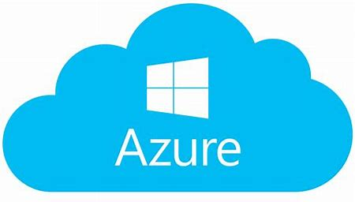
Certified Deployment of Oracle on Azure
Operating
System
Database or Application
Backup and DR
Monitoring & Management
Oracle 12.2
Certified!
Oracle 18c
Oracle DataGuard
Oracle Cloud Control
Oracle on
Oracle Enterprise Linux
Oracle 19c
Oracle RMAN
Cloud Control Express
Oracle Weblogic
http://www.oracle.com/us/corporate/pricing/authorized-cloud-environments-3493562.pdf

Slide 12
Supported Deployment of Oracle on Azure
Operating
System
Database or Application
Backup and DR
Monitoring & Management
Enterprise Redhat
Oracle 12.1
Oracle DataPump
Oracle EM 12C
SUSE Linux
Oracle Golden Gate
Oracle SQLLoader
Supported by Oracle
Supported!

Slide 13
Unsupported Deployment of Oracle on Azure
Operating
System
Database or Application
Oracle Suites
Monitoring & Management
CentOS
Oracle 11g
E-business Suite
Ubuntu
Oracle 10g
Hyperion
Oracle EM 11g
Windows
Oracle RAC
Essbase
Unsupported

Slide 14


Vendor Supported Deployment of Oracle on Azure
Operating
System
Database or Application
Backup and DR
Monitoring & Management
Oracle RAC on CloudSimple
Oracle RAC on Flashgrid
Vendor Supported
https://www.oracle.com/technetwork/database/options/clustering/overview/rac-cloud-support-2843861.pdf

Slide 15
Why Oracle 19c and what is a terminal release?
Oracle 19c is Oracle’s choice for a terminal release.
It will be the last release for this product and really is the last release of “12c”.
For those customers that don’t upgrade often or are dependent upon a vendor supported version of Oracle, a terminal release is the release to aim for.
Premier Support will continue till Mar 31, 2023, Extended Support, although requiring extra fees, will continue until Mar 31, 2026
This should be the target version for your customers for longevity of version support and sustainability.

Slide 16
Migration Tools for Oracle to the Cloud
DataPump, (expdp/impdp)
Transportable Tablespaces
RMAN Recovery/Duplicate
Cloning Technologies via Oracle
Oracle DataGuard with FarSync
Golden Gate to the Azure Cloud
VMWare to Azure using Azure Site Recovery
Azure NetApp Files

Slide 17
Licensing
Licensing is BYOL- Work with your third-party licensing as you always have.
Benefit: Single licensing agent for all Oracle
Active Dataguard is licensed different than standard dataguard, (future scope)
Savings going to single instance dataguard standbys
Inexpensive Azure blob storage for ASR is a benefit for VMs and compatible with Oracle consistent recovery.
Far Sync will require a separate Oracle instance, (as will ASM) and licensing.

Slide 18
High Availability and Disaster Recovery
Although Oracle RAC isn’t supported outside of the vendor supported versions of Flashgrid and CloudSimple…
Identify the customer’s SLA and MAA, (Maximum Availability Architecture requirements.
Hardware clustering options are available via SIOS, Azure NetApp Files and Azure Shared Storage
Always use Oracle DataGuard, which is most similar to Always on Availability Groups in Microsoft/Azure
Consider using Oracle Active DatagGuard, configure for fast failover on secondaries and use FarSync with geo-region deployments.
Use Azure Site Recovery to backup and take snapshots of Azure VMs
RMAN backups and an RMAN repository is supported on a separate VM for Oracle RMAN backups.

Slide 19
Objectives of Recovery and HA
Decision to use different recovery strategies must focus on both the Recovery Time (RTO) and Recovery Point, (RPO) objective for the business.
Where ASR snapshots are exceptionally quick to recover with, the additional recovery time to apply archive logs to bring the database to a consistent point may result in a third party solution as a better choice.
Supplementing with Oracle Dataguard, so as a replica to failover to is always available, with ASR snapshots as a second route to recovery may meet the SLA for the business.

Slide 20
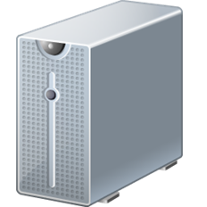
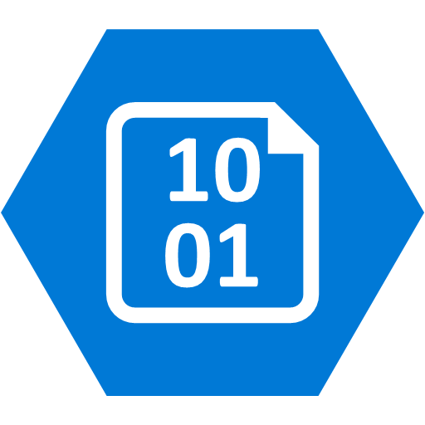
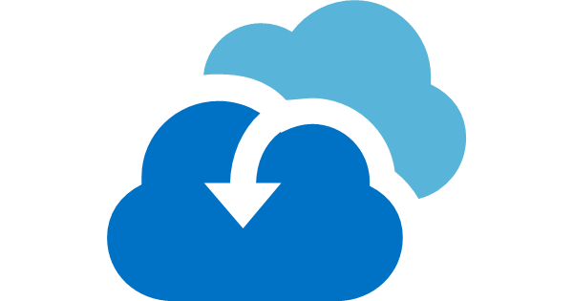
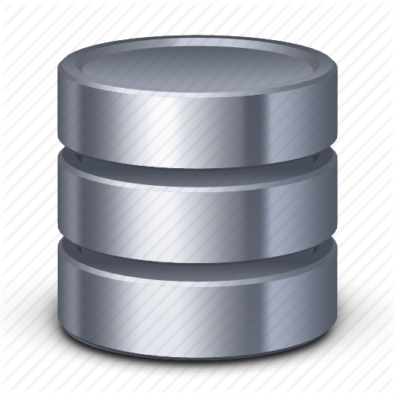

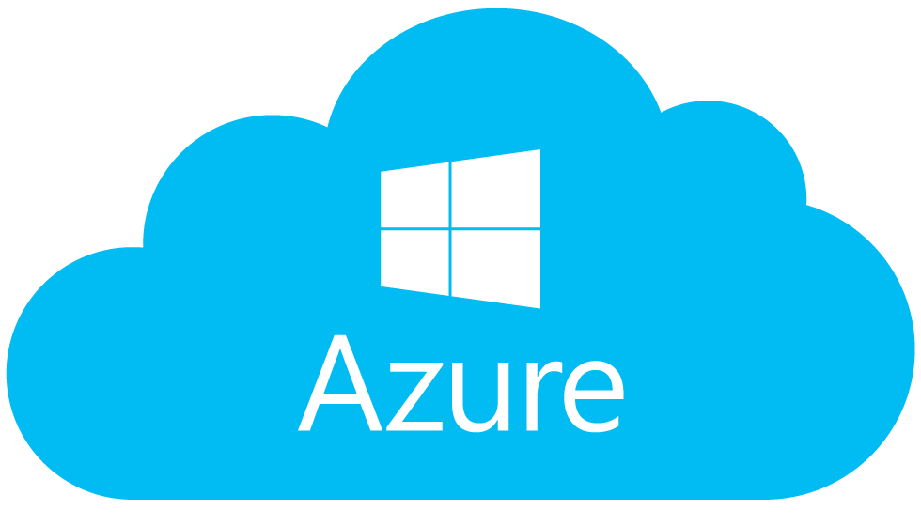
Oracle on Azure IaaS VM Architecture
App Server Backup
Create another VM copy or clone from ASR/ RMAN
VM Snapshot
RMAN Repository
Azure Site Recovery, (ASR) with Blob Storage
Backup VM to ASR
Configured with Fast Sync, (Async)
Data Guard Async Over Any Distance
Primary Oracle DataGuard
Data Guard Far Sync Instance
Active Standby Oracle Database
Primary
Azure Region
Secondary Azure Region
https://docs.microsoft.com/en-us/azure/site-recovery/
https://docs.microsoft.com/en-us/azure/virtual-machines/workloads/oracle/oracle-backup-recovery
Notes:
Emerson Architecture,
DR scenario with animations for future scope.

Slide 21
Oracle Environment Monitoring with Cloud Control
Oracle product- defector infrastructure monitoring tool since Enterprise Manager 9i
Current release is Cloud Control 13c and the repository to manage the data is supported to run in Azure on a separate Azure IaaS VM.
Infrastructure tool requiring Tuning and Diagnostic Management Packs to use.
Comes with limited enterprise edition license, (the cloud control product is free from Oracle- provide the hardware and if only running the product on the database, it doesn’t incur licensing fees outside of management packs.)
Requires the additional cloud management pack and lifecycle management pack to monitor VMs
https://www.oracle.com/technetwork/oem/enterprise-manager/documentation/index.html
https://dbakevlar.com/category/em13c/

Slide 22
Oracle Cloud Control Architecture in Azure
VM Snapshot
EM Agent installed on each VM
Cloud Control VMs
Oracle Cloud Control Repository
Oracle Cloud Control Service
Primary
Azure Region
Secondary Azure Region
https://docs.microsoft.com/en-us/azure/site-recovery/
https://docs.microsoft.com/en-us/azure/virtual-machines/workloads/oracle/oracle-backup-recovery
Notes:
Emerson Architecture,
DR scenario with animations for future scope.

Slide 23
RAC in Azure, (If needed for RAC database deployments)
Microsoft has a deep knowledge around hardware clustering and sharding vs. clustering Oracle has focused on, which is software based. Oracle *requires a very specific shared storage configuration to support RAC in a third party cloud and have chosen not to currently support RAC in any third-party cloud. This must be repeated: RAC is not supported in anyway on Azure!
Due to this, to architect an Oracle RAC environment in Azure, an intermediary layer is required.
Two currently exist:
Cloud Simple from VMWare
Flashgrid
Cloud Simple requires Vmware on Azure Bare Metal
Flashgrid can use native Azure VM images
*New Shared storage from Azure is NOT supported for Oracle RAC and support for it is not on the roadmap.

Slide 24

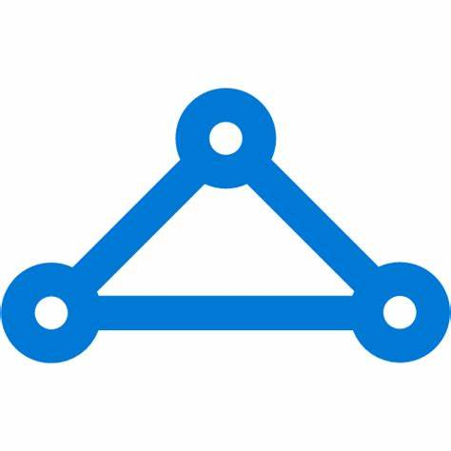
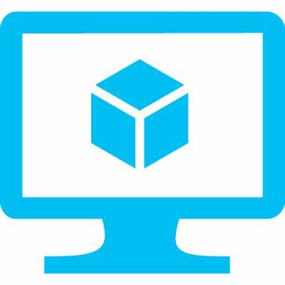
Oracle RAC with VMWare Cloud Simple
Express Route
VCenter
Azure Integration Service Platform
Esxi Hosts
Storage
Network
VMWare Cloud Simple Service Layer
Azure Bare Metal Services
https://azure.microsoft.com/en-us/services/azure-vmware-cloudsimple/

Slide 25
Oracle RAC with Flashgrid on Azure
Fault Domain 1
Fault Domain 2
Fault Domain 3
Express Route
Database Instance 2
Database Instance 3
Database Instance 1
Oracle ASM Cluster
Flashgrid Cloud Area Network
Flashgrid Storage Fabric:
Storage between all nodes
Azure Virtual Machines
https://www.flashgrid.io/oracle-rac-in-azure/

Slide 26
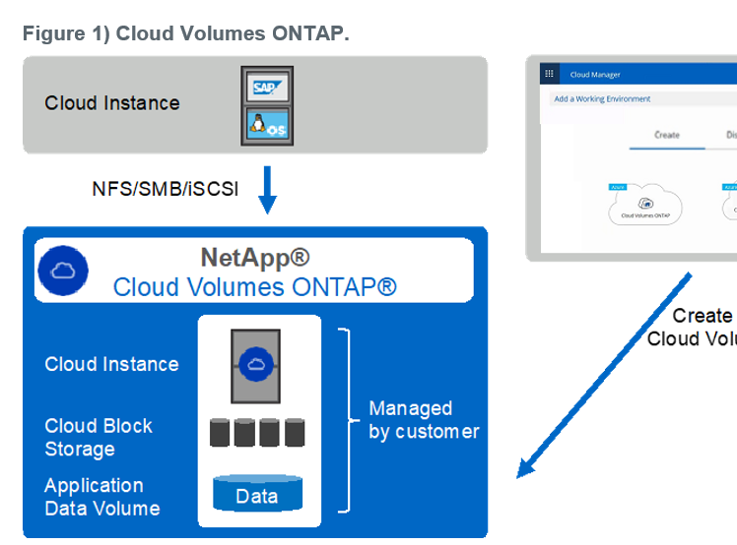
High Availability with Azure Netapp Files
Oracle Technology Partner
Cloud Volume Ontap: Build similar to a storage array in Azure to use with multiple Oracle databases.
High availability at the storage layer for those customers wanting a supported product in Azure for HA.
https://www.netapp.com/us/media/tr-4780.pdf

Slide 27
Sizing an Oracle Environment
Move the Oracle workload, not the server to the cloud.
The Automatic Workload Repository, (AWR) report is the best data to collect to size a workload from Oracle
One report, a seven-day interval MINIMUM should be used to size the workload.
The normal workload the database runs is expected, not one just testing the upper limits of the hardware.
The report resides in the database software home, ($ORACLE_HOME/rdbms/admin/awrrpt.sql)
Oracle RAC has its own combined report, same location, but awrgrpt.sql.

Slide 28
Excel Spreadsheet to Tool Conversion
Spreadsheet exists to take AWR data and convert to Azure VM size
RAC and single instance converted to single VMs
Migrates the WORKLOAD, not the server
Requires additional work for Exadata
Script to collect data outside of AWR review in the works
Currently working with the Project team to migrate a manual Excel sizing worksheet to an easily assessible tool.
ETA undetermined

Slide 29
Oracle Environment to Azure High Level Steps
Document
Begin with spreadsheet of databases to migrate or create a DR environment for.
Collect
Collect AWR reports for 24hrs or 7 days, depending on the workload type, (consistent vs. varied)
Create
Review and create a proposal.
Propose
Review with customer to ensure this meets their needs
Choose
Choose a database to use for a POC if desired
Perform
Perform POC for expected scenario
Adjust
If needed, make adjustments to architecture based off results.
Begin migration/build.
Adjust pricing, ensure customer is in agreement and begin deployment of Azure services
Begin
Agree

Slide 30
References
Oracle Dataguard on Azure:
https://docs.microsoft.com/en-us/azure/virtual-machines/workloads/oracle/configure-oracle-dataguard
Oracle Dataguard Far Sync:
https://docs.oracle.com/database/121/SBYDB/create_fs.htm#SBYDB5416
Oracle DataGuard standby from RAC to single instance:
https://docs.oracle.com/en/database/oracle/oracle-database/19/sbydb/configuring-data-guard-standby-databases-in-oracle-RAC.html#GUID-3140A293-DDD8-4559-8493-B6C21646E90F
Azure VM Sizing:
Generation 1: https://docs.microsoft.com/en-us/azure/virtual-machines/linux/sizes
Generation 2: https://docs.microsoft.com/en-us/azure/virtual-machines/linux/generation-2
Isolated Bare Metal:
https://docs.microsoft.com/en-us/azure/virtual-machines/linux/isolation
Express Route Documentation:
https://docs.microsoft.com/en-us/azure/expressroute/
Ultradisks for Azure Linux VMs:
https://docs.microsoft.com/en-us/azure/virtual-machines/linux/disks-enable-ultra-ssd

